Slide 1
Transaction Management: Transaction concept & State(Class: L34)

Slide 2
Contents
Transaction Concept
Transaction State
Implementation of Atomicity and Durability
Concurrent Executions
Serializability
Recoverability

Slide 3
Transaction Concept
A transaction is a unit of program / work (collection of operations) execution that accesses and possibly updates various data items.
A transaction must see a consistent database.
During transaction execution the database may be inconsistent.
When the transaction is committed, the database must be consistent.
Two main issues to deal with:
  Failures of various kinds, such as hardware failures and system crashes
  Concurrent execution of multiple transactions

Slide 4
Transaction properties or ACID Properties
To preserve integrity of data, the database system must ensure:
Atomicity. Either all operations of the transaction are properly reflected in the database or none are. To make changes permanent, use COMMIT and to abort the changes, use ROLLBACK.
Example : Transfer Rs 500 from account A to B
  the system should ensure that updates of a partially executed transaction are not reflected in the database
Consistency. Execution of a transaction in isolation preserves the consistency of the database. (database was in consistent state before the transaction started and it must be in consistent state after the termination of transaction. )
Example : sum of account A and B must be unchanged.

Slide 5
Isolation. Although multiple transactions may execute concurrently, each transaction must be unaware of other concurrently executing transactions. Intermediate transaction results must be hidden from other concurrently executed transactions

Slide 6
ACID Properties
  Example:
  That is, for every pair of transactions T_{i} and T_{j}, it appears to
  T_{i} that either T_{j}, finished execution before T_{i} started, or
  T_{j} started execution after T_{i} finished.
Durability. once the user has been notified that the transaction has completed successfully, the changes it has made to the database persist(remain) or permanent, even if there are system failures.

Slide 7
Example of Fund Transfer
Transaction to transfer Rs.50 from account A to account B:
  1. read(A)
  2. A := A – 50
  3. write(A)
  4. read(B)
  5. B := B + 50
  6. write(B)
Atomicity requirement — if the transaction fails after step 3 and before step 6, the system should ensure that its updates are not reflected in the database, else an inconsistency will result.
Consistency requirement – the sum of A and B is unchanged by the execution of the transaction.

Slide 8
Example of Fund Transfer (Cont.)
Isolation requirement — if between steps 3 and 6, another transaction is allowed to access the partially updated database, it will see an inconsistent database
(the sum A + B will be less than it should be).
Durability requirement — once the user has been notified that the transaction has completed (i.e., the transfer of the Rs.50 has taken place), the updates to the database by the transaction must persist despite failures.
Can be ensured trivially by running transactions serially, that is one after the other. However, executing multiple transactions concurrently has significant benefits, as we will see.

Slide 9
Why Concurrency Control is needed ?
To overcome The Isolation Problems
  Dirty read – Write read
  Unrepeatable – Read Write
  Lost update – Write write

Slide 10
Dirty Read or Temporary Update or Write Read Conflict
Occurs when one transaction updates a database item and then the transaction fails for some reason.
The update item is accessed by another transaction before it is changed back to the original value.

Slide 11
Example:
Name | Sal | Dept
Marry | 300 | CSE
Scott | 500 | IT
John | 1000 | ECE
10 am : Start TX1
10.10 am: set mary’s
sal to 500
10.20 am : commit
10.15 am : Start TX2
10.16 am: read all sal
T1 | T2
Write (X) Commit | Read(X)

Slide 12
Incorrect Summary Problem
If one Tx is calculating an aggregate summary function on a no of records while other Tx are updating some of these records,
the aggregate function may calculate some values before they are updated

Slide 13
Example:
Name | Sal | Dept
Marry | 300 | CSE
Scott | 500 | IT
John | 1000 | ECE
10 am : Start TX1
10.05 am: set mary’s
sal to 500
10.08 am : set scott’s
sal to 1000
10.06 am : Start TX2
10.07 am: sum all sal
(500+500+1000)
10.08 am: sum all sal
(500+1000+1000)
T1 | T2
Write1(x) Write1(x) | Write2(x) Write2(x)

Slide 14
Unrepeatable Read
A Tx reads an item twice and the item is changed by another Tx1 between the two reads

Slide 15
Example:
Name | Sal | Dept
Marry | 300 | CSE
Scott | 500 | IT
John | 1000 | ECE
10 am : Start TX1
10.05 am:read all sal
10.15 am :read all sal
10.06 am : Start TX2
10.07 am:set marys
Sal to 700
10.08 am : commit
T1 | T2
read1 (x) read1(x) | write2(x) commit

Slide 16
Repeatable Read (RW conflict)
only committed records to be read, repeated reads of same record must return same value. However, a transaction may not be serializable – it may find some records inserted by a transaction but not find other data inserted by the same transaction.

Slide 17
Example:
Name | Sal | Dept
Marry | 300 | CSE
Scott | 500 | IT
John | 1000 | ECE
10 am : Start TX1
10.05 am:read all sal
10.15 am :read all sal
10.06 am : Start TX2
10.07 am:
insert (‘mira’,’600’,’HR’)
10.08 am : commit
T1 | T2
read1 (x) read1(x) | write2(x) commit

Slide 18
Unstable Cursor :
A wants to something which is deleted by B.

Slide 19
Example:
Name | Sal | Dept
Marry | 300 | CSE
Scott | 500 | IT
John | 1000 | ECE
10 am : Start TX1
10.05 am:
set mary’s sal to 500
10.15 am :read all sal
10.10 am : Start TX2
10.11 am: drop sal
column
10.12 am : commit
T1 | T2
write1(x)

Slide 20
Lost Update Problem
Occurs when two Tx’s access the same database items have their operations interleaved in a way that makes the value of some database items incorrect

Slide 21
Example:
Name | Sal | Dept
Marry | 300 | CSE
Scott | 500 | IT
John | 1000 | ECE
10 am : Start TX1
10.10 am:
set mary’s sal to 500
10.11 am :commit
10.05 am : Start TX2
10.06 am: set mary’s
sal to 600
10.07 am : commit
T1 | T2
Write1(x) commit1 | Write2(x) commit2

Slide 22
Transaction Model or
Transaction States
Active, the initial state; the transaction stays in this state while it is executing
Partially committed, after the final statement has been executed.
Failed, after the discovery that normal execution can no longer proceed.
Aborted, after the transaction has been rolled back and the database restored to its state prior to the start of the transaction. Two options after it has been aborted:
  restart the transaction – only if no internal logical error (it was aborted because of h/w and s/w error)
  kill the transaction: internal logical error. To correct it re-write the application program.
Committed, if its execution is successfully complete or after successful completion.

Slide 23

Transaction State (Cont.)

Slide 24
Transaction Operations
BEGIN Transaction
READ or WRITE
END Transaction
COMMIT Transaction
ROLLBACK (or ABORT)

Slide 25
Implementation of Atomicity and Durability
The recovery-management component of a database system implements the support for atomicity and durability.
The shadow-database scheme:
  The scheme, which is based on making copies of the database, called shadow copies
  assume that only one transaction is active at a time.
  a pointer called db_pointer always points to the current consistent copy of the database.
  all updates are made on a shadow copy of the database, and db_pointer is made to point to the updated shadow copy only after the transaction reaches partial commit and all updated pages have been flushed to disk.
  in case transaction fails, old consistent copy pointed to by db_pointer can be used, and the shadow copy can be deleted.

Slide 26
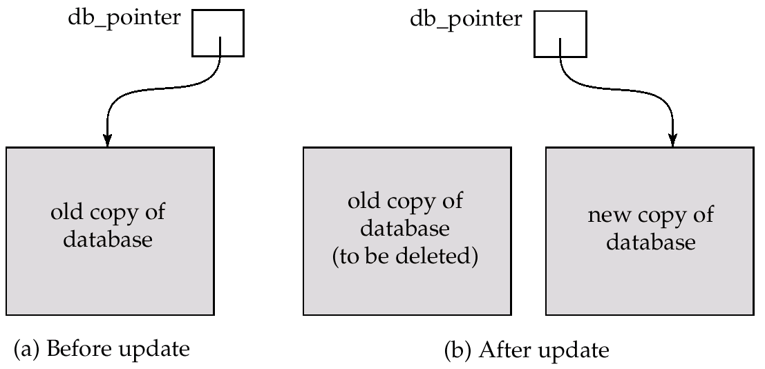
Implementation of Atomicity and Durability (Cont.)
The shadow-database scheme:
Assumes disks to not fail
Useful for text editors, but extremely inefficient for large
databases: executing a single transaction requires copying the
entire database.

Slide 27
Concurrent Executions
Multiple transactions are allowed to run concurrently in the system. Advantages are:
  increased processor and disk utilization, leading to better transaction throughput: one transaction can be using the CPU while another is reading from or writing to the disk
  reduced average response time for transactions: short transactions need not wait behind long ones.
Concurrency control schemes – mechanisms to achieve isolation, i.e., to control the interaction among the concurrent transactions in order to prevent them from destroying the consistency of the database

Slide 28
Schedules
Schedules – sequences that indicate the chronological order in which instructions of concurrent transactions are executed
Or schedule is an order in which transactions are executed in the system.
Two types
  Serial schedule.
  Concurrent schedule.
  a schedule for a set of transactions must consist of all instructions of those transactions
  must preserve the order in which the instructions appear in each individual transaction.

Slide 29

Example Schedules
Let T₁ transfer Rs. 50 from A to B, and T₂ transfer 10% of the balance from A to B. The following is a serial schedule (Schedule 1 in the text), in which T₁ is followed by T₂.

Slide 30

Example Schedule (Cont.)
Let T₁ and T₂ be the transactions defined previously. The following schedule (Schedule 3 in the text) is not a serial schedule, but it is equivalent to Schedule 1.
In both Schedule 1 and 3, the sum A + B is preserved.

Slide 31

Example Schedules (Cont.)
The following concurrent schedule (Schedule 4 in the text) does not preserve the value of the the sum A + B.

Slide 32
Serializability of Schedule
Concurrent schedule is serializable or has serializability property if its outcome is equivalent to serial schedule.
Serializability property of schedule means its equivalent to a serial schedule.
Two types:
  Conflict serializability
  View serializability.

Slide 33
Recoverability of schedule
Serializability check whether the concurent schedule is acceptable, assuming no transaction failures.
But failure can occur at any time.
So schedule also needed to process recoverability properties.
Recoverability means transaction haven't read the data written by aborted transaction , and whose effect don't exist in resulting database state.

